Slide 1
Vulnerable Banks
Robin Greenwood (HBS & NBER)
Augustin Landier (Toulouse)
David Thesmar (HEC Paris & CEPR)
november 2011

Slide 2
Systemic Risk
Risk of collapse of financial system due to contagion
Two kinds of linkages:
  inter-bank contracts
  fire sales spillovers: this paper
Quasi-structural model of liquidation spiral → Measure of:
  Vulnerability of each bank to systemic risk
  Contribution of each bank to systemic risk
  Interconnectedness between 2 banks
  Aggregate vulnerability
Applications:
  European banks & sovereign risk
  US banks and financial institutions through the Lehman crisis

Slide 3
Intuition
Dexia
Italian bonds =15 bn
E = 17bn
Greek bonds =3.4 bn
D = 530bn
leverage = 530/17

Slide 4
Intuition
Dexia
Italian bonds =15 bn
E = 17bn
Greek bonds =3.4 bn
D = 530bn
60% haircut
leverage = 530/17

Slide 5
Intuition
Dexia
Dexia
Italian bonds =15 bn
E = 17bn
Italian bonds =15 bn
E = 15bn
Greek bonds =3.4 bn
Greek bonds =2 bn
D = 530bn
D = 530bn
60% haircut
leverage = 530/17
leverage = 530/15

Slide 6
Intuition
To keep same leverage (530/17),
DEXIA needs to sell (530/17)x 2 = 62bn of assets
Dexia
Dexia
Italian bonds =15 bn
E = 17bn
Italian bonds =15 bn
E = 15bn
Greek bonds =3.4 bn
Greek bonds =2 bn
D = 530bn
D = 530bn
60% haircut
leverage = 530/17
leverage = 530/15

Slide 7
Intuition
To keep same leverage (530/17),
DEXIA needs to sell (530/17)x 2 = 62bn of assets
➔ proportionally: 62 x 15 / 545 = 2bn of italian bonds
➔ price impact on Italian Bonds = 10e-11 x 2bn = 2%
Dexia
Dexia
Italian bonds =15 bn
E = 17bn
Italian bonds =15 bn
E = 15bn
Greek bonds =3.4 bn
Greek bonds =2 bn
D = 530bn
D = 530bn
60% haircut
leverage = 530/17
leverage = 530/15

Slide 8
Intuition
Commerzbank
E = 15bn
E = 26bn
Dexia
Italian bonds =11 bn
Italian bonds =15 bn
Greek bonds =3 bn
D = 745bn
Greek bonds =2 bn
D = 530bn
Indirect contamination of Commerzbank:
Loss on Italy = 2% x 11bn = 220m
= 0.03% of assets

Slide 9
What this framework delivers
Empirical measures of how much:
  1 bank can hurt the others (“Systemicness”)
  1 bank can be hurt by others (“Vulnerability”)
  2 banks are connected (“Cross vulnerability”)
  Overall system is vulnerable
  (“Aggregate vulnerability”)
Policy analysis :
  What if we merge one bank with another, what happens to systemic risk?
  What happens if we cap size or leverage?

Slide 10
3 Ingredients needed / Assumptions
What amount of assets do banks liquidate following shock?
  Assume they liquidate some assets to keep leverage constant
  No equity issuance
In what proportions do they liquidate assets?
  Assume they liquidate in proportion to weight in existing holdings
    Keep assets’ weighting unchanged
Price impact of fire sales?
  Assume Amihud ratios: returns proportional to dollar sale

Slide 11
Framework: 3 steps
From asset shock to bank portfolio values
  Matrix of Bank holdings/ risk exposures
From leverage shock to fire sales / buys
  Liquidation rule (proportional)
From fire sales to bank returns
  Price impact

Slide 12
Notation
N banks, K assets
F_{t} = Vector of Asset Returns:
M = Matrix of bank weights in diff’t assets:
B = Diagonal matrix of bank leverage (d/e)
A = Diagonal matrix of bank’s asset values (in $ or Euro)
L = Diagonal matrix of price impact ratios by assets

Slide 13
Step #1: from Asset shocks to Bank assets
R = Vector of banks’ portfolio returns (aka unlevered returns):

Slide 14
Step #2: from bank shocks to fire sales
Bank with assets=100; shock = -1.
To keep leverage constant , need to sell - (d/e) x A x (-1%)
➔ In matrix terms: vector of dollar
asset purchases/sales = BAR_{t}
If asset A₁ is w% of portfolio: sale of A₁ = w x (d/e) x A₁ x (-1)
➔ In matrix terms: Vector of asset purchases/sales = M’BAR_{t}
A 100
E 10
D 90
A 99
E 9
D 90
A 90
E 9
D 81

Slide 15
Step #3: from assets sales to bank returns
Order imbalances lead to temporary movements in asset prices
F_{t+1} = L x Net Asset Buys
Bank returns are impacted by asset price movements
R_{t+1} = M x F_{t+1} = ML x Net Asset Buys
Illiquidity: Amihud ratios

Slide 16
Combining the two last steps
From bank shock to each Bank
R_{t+1} = ML x asset buys = (MLM’BA) x R_{t}
From asset shock to each Bank
R_{t+1} =(MLM’BA) x MS_{t}
Connectedness Matrix
Shock to Assets

Slide 17
Aggregate Vulnerability
S is a vector of shocks to asset returns
  Canonic case: 1 s.d. shocks to all assets
  In Europe: shock to weak sovereigns
Aggregate $ indirect impact of S on all bank assets (normalized by aggregate equity):
Aggregate Vulnerability:
AV = (1’AMLM’BAMS)/E
Aggregate vulnerability high when large asset classes are held by banks that are relatively large, levered, exposed to volatile assets.
Warning: Aggregate $ direct impact of S on banks : 1’AMS

Slide 18
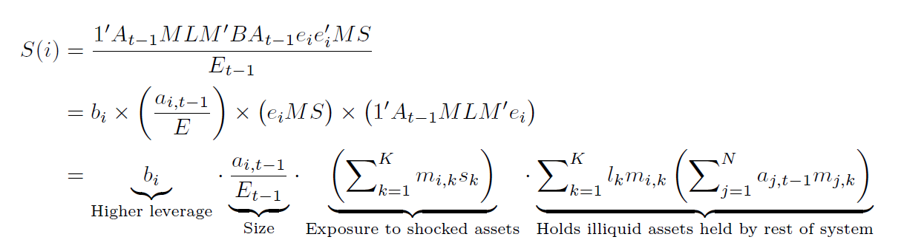
Systemicness
Systemicness of bank i, S(i) = aggregate indirect impact of shock S through bank i
(AV = sum of all S(i))
(Linkage effect)

Slide 19
Vulnerability
Vulnerability of bank i to deleveraging
Careful: different from “direct” exposure:

Slide 20
Cross-bank vulnerability
Suppose bank j hit by shock…
What is the impact on bank i ?
➔ This will serve to test the empirical validity of the framework

Slide 21
Building intuition: diversification
Suppose 2 banks have identical leverage and there are two assets
Which is best for aggregate systemic risk?
    Both banks have identical portfolios?
    Or each bank owns only one asset, and all of it ?
Making banks similar is good iff most volatile asset is also most illiquid
Two opposing effects:
  Spreading volatile asset across banks → less average dollar liquidations
  …But now some of the other asset will get liquidated

Slide 22
Systemic Intuition: slicing is neutral
Cut a bank into 2 banks of similar asset weights and leverage:
Effect on Aggregate Vulnerability: NONE

Slide 23
Systemic Intuition: mergers
Merge 2 banks:
  Heterogeneous assets and leverage
2 effects :
  Leverage of merged entity is smaller than asset-weighted leverage:
  →stabilizing
  Portfolio effect: stabilizing iff most volatile also most illiquid

Slide 24
Applications-- Overview
Largest Euro banks
  Exposures taken from the EBA stress tests
Largest 100 US financial institutions
  Our estimates based on weekly market leverage and factor exposures
  I will skip this today

Slide 25
European Banks
M matrix (exposures)
  EBA stress tests data (90 largest banks in the EU27; july 2011)
    Sovereigns, per country
    Mortgages, commercial real estate, corporate loans, retail SMEs, consumer loans
B, A, R from datastream
  Use book leverage (→can include private )
Shock vector S
  50% write-down on all 5 PIIGS
  L = (10e-13) Id : identical liquidity of assets

Slide 26
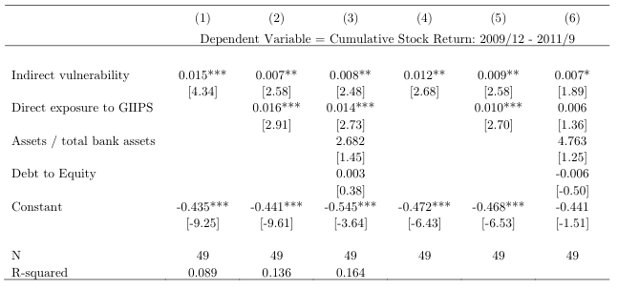
Validation: Explaining Stock Returns
Table 7: Compare realized stock returns (jan 2010-sep 2011)
to V(i) Works even controlling for direct exposure to shock

Slide 27
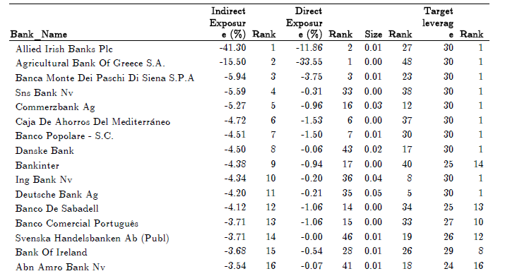
AV: Vulnerability ranking
Table 6, PIIGS writedown

Slide 28
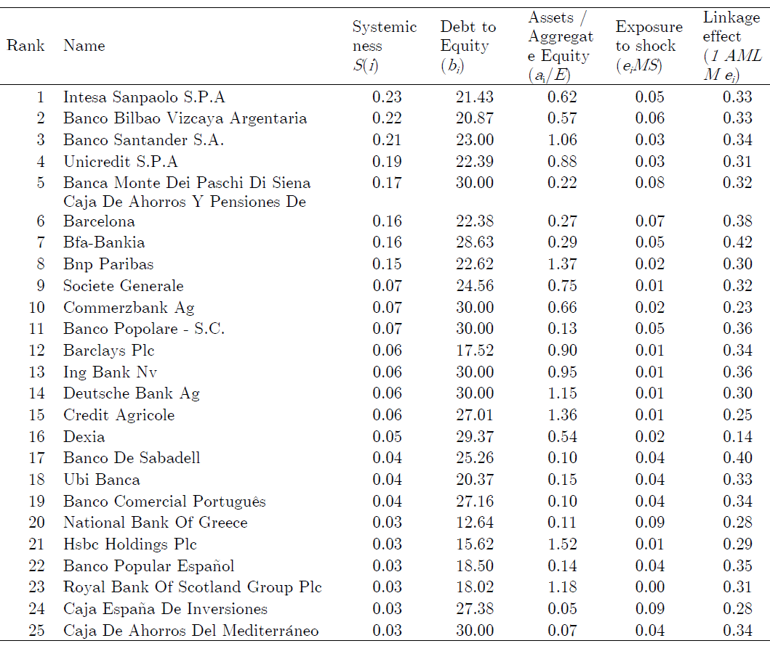
S(i): Systemicness
Table 8, PIIGS writedown

Slide 29
Policy Interventions
Table 9
Consider
  Baseline
  Size cap (500, 900, 1300 bn euros)
  Cap leverage
  Merge banks which are most directly exposed to writedown shock
Of these interventions, only leverage caps have a major effect
  But requires massive rebalancing: 480bn euros to cap leverage @ 15
Size cap does not work b/c larger banks are not more levered
Merging banks does not work b/c of two countervailing forces

Slide 30
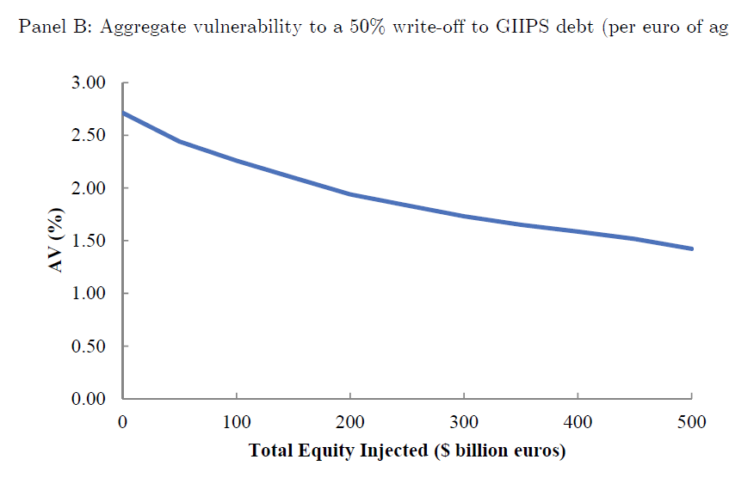
Optimal Equity Injections
By design, optimal injection in a given bank has strong correlation with overall systemicness

Slide 31
Summary
Simple framework yields number of useful measures and insights
Our key contribution relative to other measures
  Quasi-structural but highly tractable
  Isolating specific mechanism (fire sale contagion)
  Able to perform policy experiments
Regulating through liquidation constraints?
Still more to do to on robustness
More detail in the paper on all of this

