Slide 1
Financial institutions’ business models and the global transmission of monetary policy
Isabel Argimonª, Clemens Bonner^{b,d}, Ricardo Correa^{c}, Patty Duijm^{b},
Jon Frost^{b,d,e}, Jakob de Haan^{b,f,g}, Leo de Haan^{b}, and Viktors Stebunovs^{c}
ª Banco de Espana | ^{e} Financial Stability Board
^{b} De Nederlandsche Bank | ^{f} University of Groningen
^{c} Federal Reserve Board | ^{g} CESifo
^{d} VU University Amsterdam
GLOBAL FINANCIAL LINKAGES AND MONETARY POLICY TRANSMISSION
June 30, 2017
The views expressed in this paper are the responsibility of the authors and not of the institutions that they are affiliated with.

Slide 2
Introduction
Financial institutions transmit monetary policy to the real economy
As they have increased their global reach, they may transmit monetary policy (MP) internationally—from their home countries to other countries
Study such international transmission conditional on global financial institutions’ business models
Confidential supervisory data for banks from three structurally different systems—Dutch, Spanish, and U.S.—and for Dutch insurance companies and pension funds
A unique perspective on the role of business models in international transmission
Across banking systems
Within banking systems
Across types of financial intermediaries

Slide 3
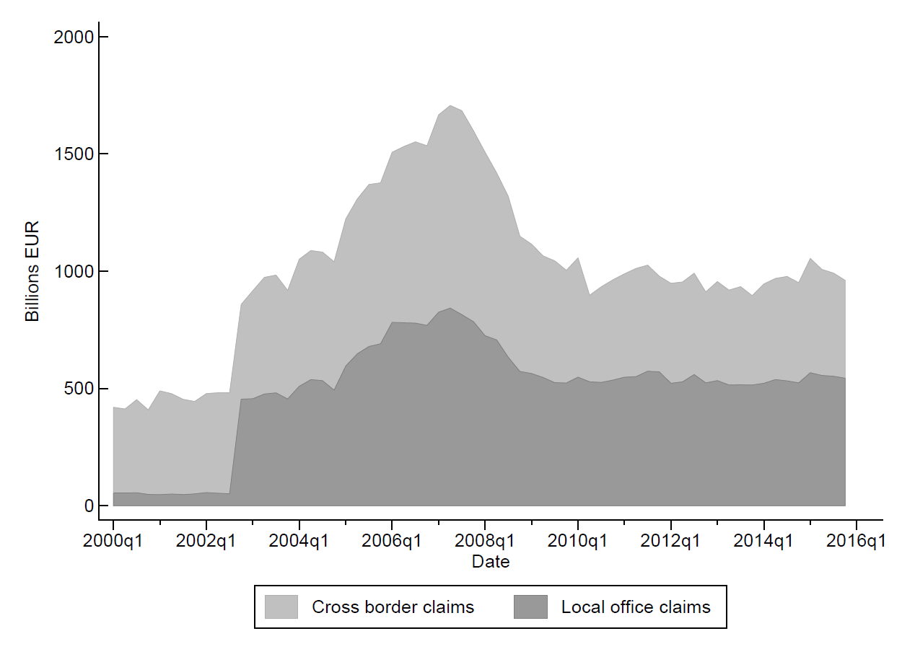
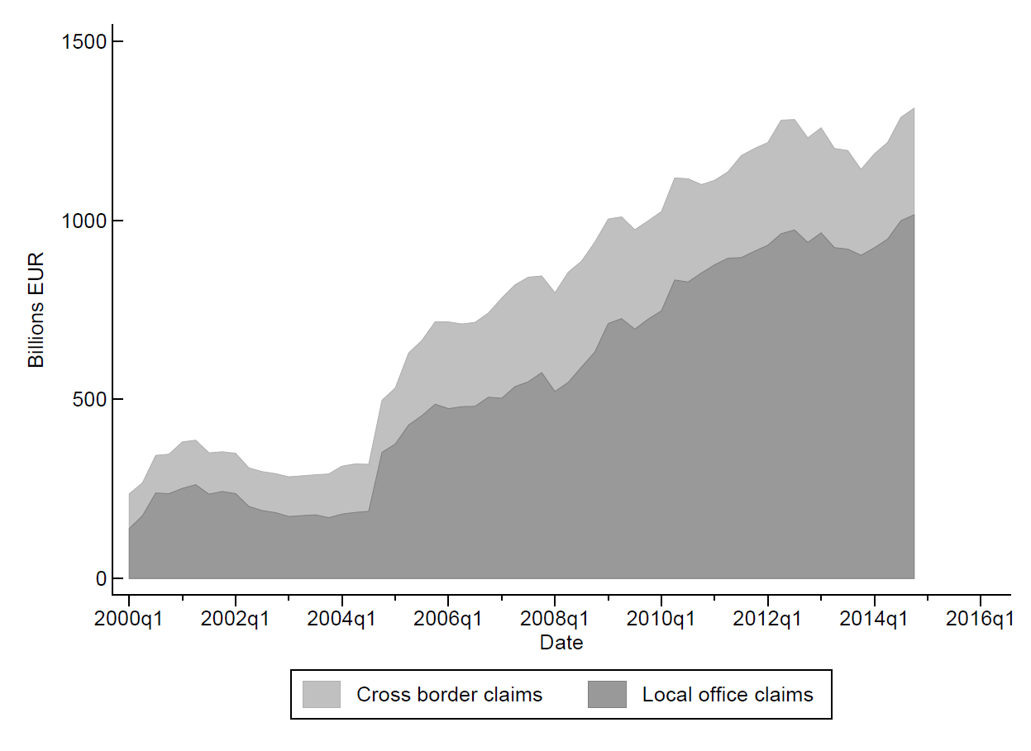
Dutch, Spanish, and U.S. banks’ foreign claims
NL
SP
Three banking systems have sizeable foreign claims
For Spanish system, local office claims dominate cross-border claims by a huge margin
In contrast, for U.S. system, cross-border claims dominate
Dutch system falls in between
U.S.

Slide 4
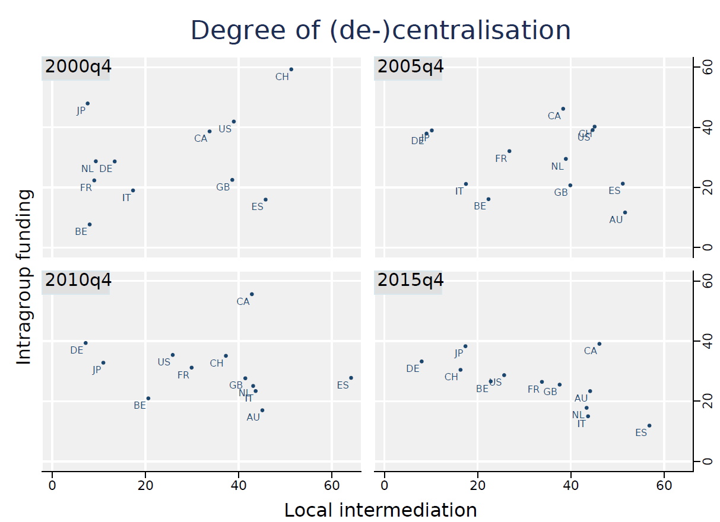
Business models cover the entire spectrum
Two-way comparison at a system level using BIS data:
Spanish system: Less intragroup funding, more local claims/liabilities
Dutch and U.S. systems: Changed over time, U.S. model is opposite of the Spanish, Dutch model in between
Here: One-way comparison at a bank level using supervisory data:
“International banks” lend to foreign residents from head offices
“Multinational” banks from foreign offices
Note: Intragroup funding is the share of total foreign intragroup liabilities to total liabilities. Local intermediation is the minima of local assets and local liabilities for each counterparty country summed over all counterparties and then divided by total foreign claims.

Slide 5
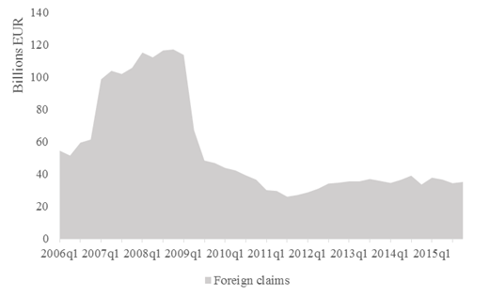
Dutch insurers & pension funds’ cross-border claims
Insurers
Pension funds
Insurance companies and pension funds sector is smaller than the banking sector
Pension funds are x2 larger than insurance companies, lend more internationally
Lend to foreign residents from head offices

Slide 6
Baseline and channel regressions
Quarterly data beginning 2000, with over 25 banks in each system, cannot combine systems
Effect of a change in home country policy rates (ΔMP^{domestic}) on growth of foreign claims of each bank on each host country (ΔY_{b,j}) (baseline)
Identify channels of transmission through variation across banks within a system
α₁s the direct, system-specific effect and α₂·${\text{Channel}}_{b}$s the differential effect conditional on a bank’s characteristic, total effect evaluated at different percentiles
Channels: Bank lending (liquidity, size), portfolio (capital, asset compositions), and international lending model (bank rather than bank-country specific)

Slide 7
Estimated regressions for banks
LHS variable | Bank lending channel RHS |  | Portfolio channel RHS
Total foreign claims | Short-term policy rate (can go negative in the euro area) | * Short-term funding ratio * Liquid asset ratio * Log(total assets) | Shadow rate (can go negative in both the euro area and the U.S.) | * Tier 1 leverage ratio * C&I to total assets ratio * Securities to total assets ratio * Total foreign claims to total assets ratio
Non-bank private claims
Not exactly the same channels for insurers and pension funds
Can estimate separately for non-euro area claims
Better identify the effects of euro-area monetary policies

Slide 8
System models and bank lending channel
U.S. banks with more short-term funding increase foreign claims as U.S. MP tightens
Larger Spanish and U.S. banks increase total foreign claims as home MP tightens
In contrast, Dutch banks—even larger ones—decrease total foreign claims as policy tightens, but…

Slide 9
System models and portfolio channel
U.S. banks with lower capital levels increase foreign claims as home MP tightens
Similar result for median Dutch banks’ private foreign claims
Spanish banks adjust differently: Banks with more foreign claims increase private foreign claims as home policy tightens, total effect not statistically significant

Slide 10
Business models for international lending
Multinational Dutch banks increase private foreign-office claims as home MP tightens
Multinational Spanish banks increase private cross-border claims as policy tightens, tilting the compositions of their assets towards foreign claims
Complement to the activities conducted in foreign offices?

Slide 11
Insurance companies and pension funds
Insurance companies and pension funds react less to monetary policy changes
Size matters: Larger insurers and funds offset the direct effect of monetary policy on private foreign claims

Slide 12
Conclusions
Compare transmission across banking systems, within banking systems, and across types of financial intermediaries
Among the systems, U.S. banks are more sensitive to home MP changes
Within banking systems, these channels operate
Lending: Total assets: Positive conditional effect, overall effect not clear
Portfolio: Tier 1 leverage: Dutch and U.S. banks with lower capital levels increase private foreign claims as home policy tightens, but not Spanish banks
International lending: Multinational Dutch and Spanish banks adjust private foreign claims, but not multinational U.S. banks
Across types, insurers and pension funds react less to home MP changes
Larger insurers and funds offset the direct effect of MP on private foreign claims
Policymakers can assess whether the structure of certain financial systems are more or less conducive to spillovers into other countries

Slide 13
Back-up slides

Slide 14
Total effect = Direct effect + Conditional effect
Too many coefficients of interest, focus on the total effect of MP changes on international lending conditional on a channel
$$∂∆Y/∂∆MP= \sum_{k=0}^{K}{\left(α_{1,k}+α_{2,k}∙Channel or Decentral\right)}$$
Note that $α_{1,k}$s and $α_{2,k}$s may have opposite signs
Evaluate the total effects for each banking system conditional on 25th, 50th, and 75th percentiles of a given channel variable
Approach highlights heterogeneity across systems and within systems
Similar exercise for Dutch insurance companies and pension funds

